Slide 1
Landis Partner Breakfast
Leveraging Resources
12.13.18

Slide 2
Meeting Outcomes
Facilitate connections between Landis Center for Community Engagement and community partners
Learn about successful collaborations between faculty and partners
Think about opportunities for future collaborations

Slide 3
Agenda
Introductions
Provide Overview
Research Questions
Partnership Guidelines
Presentations
Dr. Jonathan Bloom - Math 306, Easton Public Market
Dr. Christopher Ruebeck - Independent Study, Cheston Elementary
Dr. Trent Gaugler, Michelle Foley, Staci Zsilavecz
Discussion & Brainstorming
Wrap-up
Notes:
Introductions (30 Minutes)
Name, Organization or Department, 30 second elevator pitch
Possible Research Questions (10 Minutes)
Presentations (10 Minutes each - 20 Minutes Total)
Dr. Jonathan Bloom - Math 301, Easton Public Market
Dr. Christopher Ruebeck - Independent Study, Cheston Elementary
Dr. Trent Gaugler, Michelle Foley, Staci Zsilavecz
Discussion (10 minutes)
Break-up into three groups and brainstorm any one or two research questions
Wrap-up (15 Minutes)
Highlight key takeaways from discussion

Slide 4
Research Questions
How can your program be more effective?
Are you meeting your community’s needs?
How are external factors influencing the success of your programs?
How does the community view your programs or organization?
How can you collaborate and share services with other community organizations?
How do your relationships with your clients affect their well-being? Your well-being?

Slide 5
Partnerships
Faculty and community partner(s) collaborate
Fair exchange of resources
Assessment

Slide 6
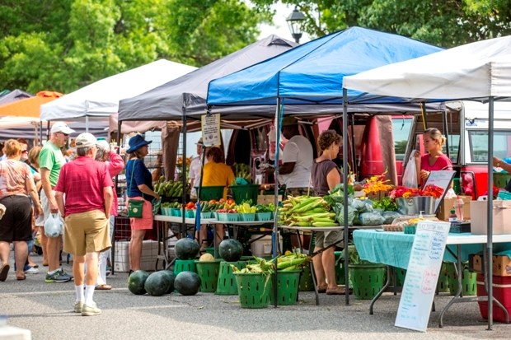
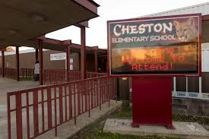
Presentations

Slide 7
Discussion/Brainstorming
Break into small groups to discuss possible research questions

Slide 8
Wrap-Up (Further Action)
Future meeting topics
Guest speakers
Workshop topics
Community events
Widening communication pathways
Other suggestions

